Slide 1
GraphANN
Vamana Index Optimization — A Systematic Performance Study
SIFT1M Benchmark · 1M 128-dim Vectors · K=10

Slide 2
What We Studied
05
H
Random Start Baseline
ATVB + SIMD Float32
01
06
The unoptimized Vamana graph — our ground truth
Hardware-level accelerator
Medoid Start
ATVB + SIMD + SQ8 + Medoid
02
06
Smarter initialization from the dataset center
Memory compression: 4× smaller vectors
Two-Pass Build (Serial)
Parallel Search + SQ8
03
07
Attempted graph refinement — a useful failure
Throughput vs tail-latency trade-off
Parallel Two-Pass + SQ8
PQ + ADC + SQ8 Reranking
04
08
Two-stage coarse→precise pipeline
Aggregation of the above 3 models

Slide 3
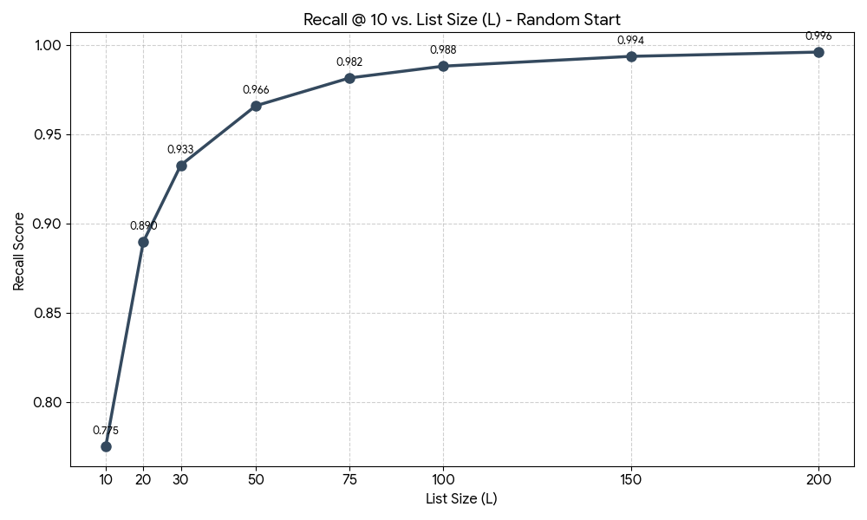
Config 1 — Random Start Baseline
What: Unmodified Vamana — random entry node 637542, single pass, float32, no parallelism.
Why: Establish ground-truth benchmarks. Every optimization is measured against this.
Build Time
RAM (float32)
Recall @L=200
Latency @L=200
76 s
488 MB
0.9960
1,496 µs
Fast single pass
Massive footprint
Near-perfect recall
Slow at high L
Results Table (K=10)
L | Recall@10 | Avg Dist Cmps | Avg Latency (µs) | P99 Latency (µs)
10 | 0.7750 | 653.9 | 190.7 | 1230.5
20 | 0.8896 | 894.1 | 255.0 | 1004.1
50 | 0.9659 | 1522.0 | 444.3 | 1302.8
100 | 0.9881 | 2448.6 | 742.0 | 1481.5
150 | 0.9936 | 3284.1 | 1049.5 | 2019.7
200 | 0.9960 | 4058.5 | 1495.6 | 5154.6

Slide 4
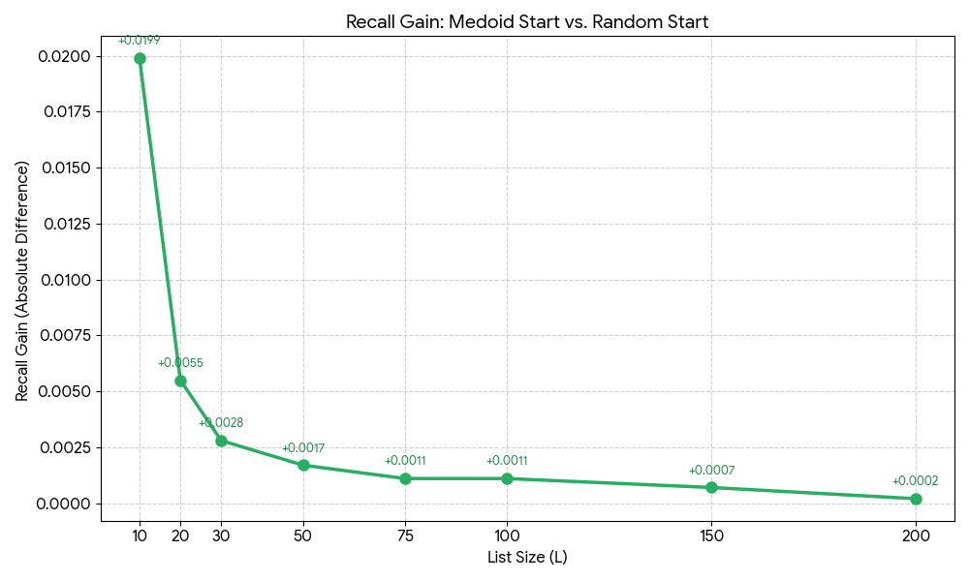
Config 2 — Medoid Start Initialization
What: Replace random entry node with the dataset medoid (node 123742) — the geometric center minimizing average distance to all points.
Why: Any query must traverse through the high-density center. Starting there reduces wasted hops, especially at small L.
Recall @L=10 gain
Recall @L=200
Extra Cost
+2.0%
0.9962
Zero
0.7750 → 0.7949
Marginal gain at high L
No RAM or latency penalty
Recall Improvement vs Baseline
L | Random Recall | Medoid Recall | Improvement
10 | 0.7750 | 0.7949 | +0.0199
20 | 0.8896 | 0.8951 | +0.0055
50 | 0.9659 | 0.9676 | +0.0017
100 | 0.9881 | 0.9892 | +0.0011
200 | 0.9960 | 0.9962 | +0.0002

Slide 5
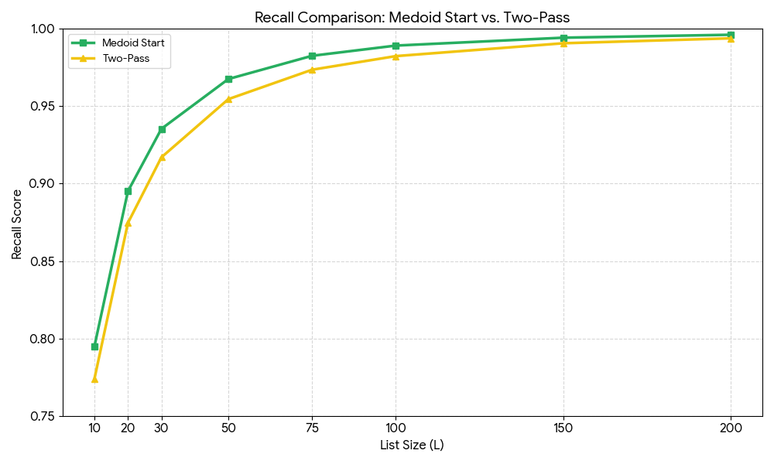
Config 3 — Two-Pass Serial Build
What: Rebuild the index twice — pass 2 uses pass 1 graph as warm start, merging neighbors and re-pruning.
Why it failed: Alpha-RNG pruning assumes independent candidates. Pass 2 candidates are biased by pass 1, violating this assumption → noisy edges → out-degree 33→37.6 → over-densification → recall drops.
Build Time
Out-degree
Recall @L=10
Recall @L=200
148.7 s
37.6
0.7739
0.9939
2× slower
vs 33.1 baseline
Worse than baseline!
Still degraded
L | Medoid Recall | Two-Pass Recall | Change
10 | 0.7949 | 0.7739 | −0.0210 ▼
20 | 0.8951 | 0.8746 | −0.0205 ▼
50 | 0.9676 | 0.9546 | −0.0130 ▼
100 | 0.9892 | 0.9824 | −0.0068 ▼
200 | 0.9962 | 0.9939 | −0.0023 ▼

Slide 6
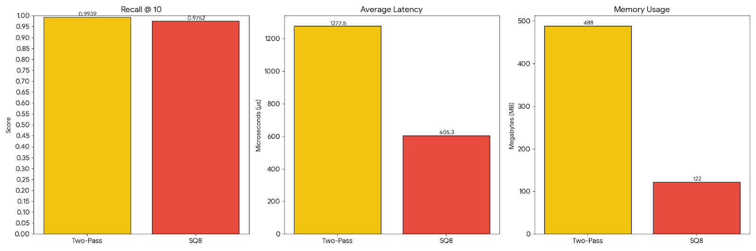
Config 4 — Parallel Two-Pass + SQ8 + Medoid
What: Fix Config 3's failure by parallelizing both passes with OpenMP. Thread-randomized insertion breaks the correlation that violated alpha-RNG's independence — pass 2 genuinely adds diverse edges. Combined with SQ8 + medoid.
Avg Lat @L=200
P99 Lat @L=200
RAM
Recall @L=200
605 µs
1,350 µs
122 MB
0.9752
2.4× faster than baseline
3.8× lower tail
75% less than baseline
~2% recall trade-off
L | Recall@10 | Avg Dist Cmps | Avg Latency (µs) | P99 Latency (µs)
10 | 0.7899 | 538.8 | 93.1 | 222.7
20 | 0.8847 | 768.1 | 100.6 | 213.5
50 | 0.9488 | 1381.0 | 195.2 | 412.5
75 | 0.9627 | 1850.1 | 269.1 | 520.7
100 | 0.9686 | 2289.9 | 338.5 | 706.8
150 | 0.9734 | 3106.7 | 479.7 | 970.5
200 | 0.9752 | 3863.2 | 605.3 | 1349.8

Slide 7
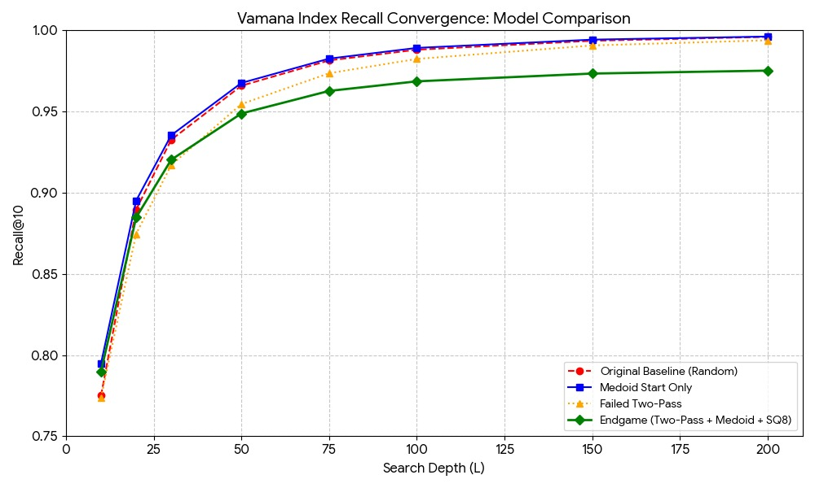
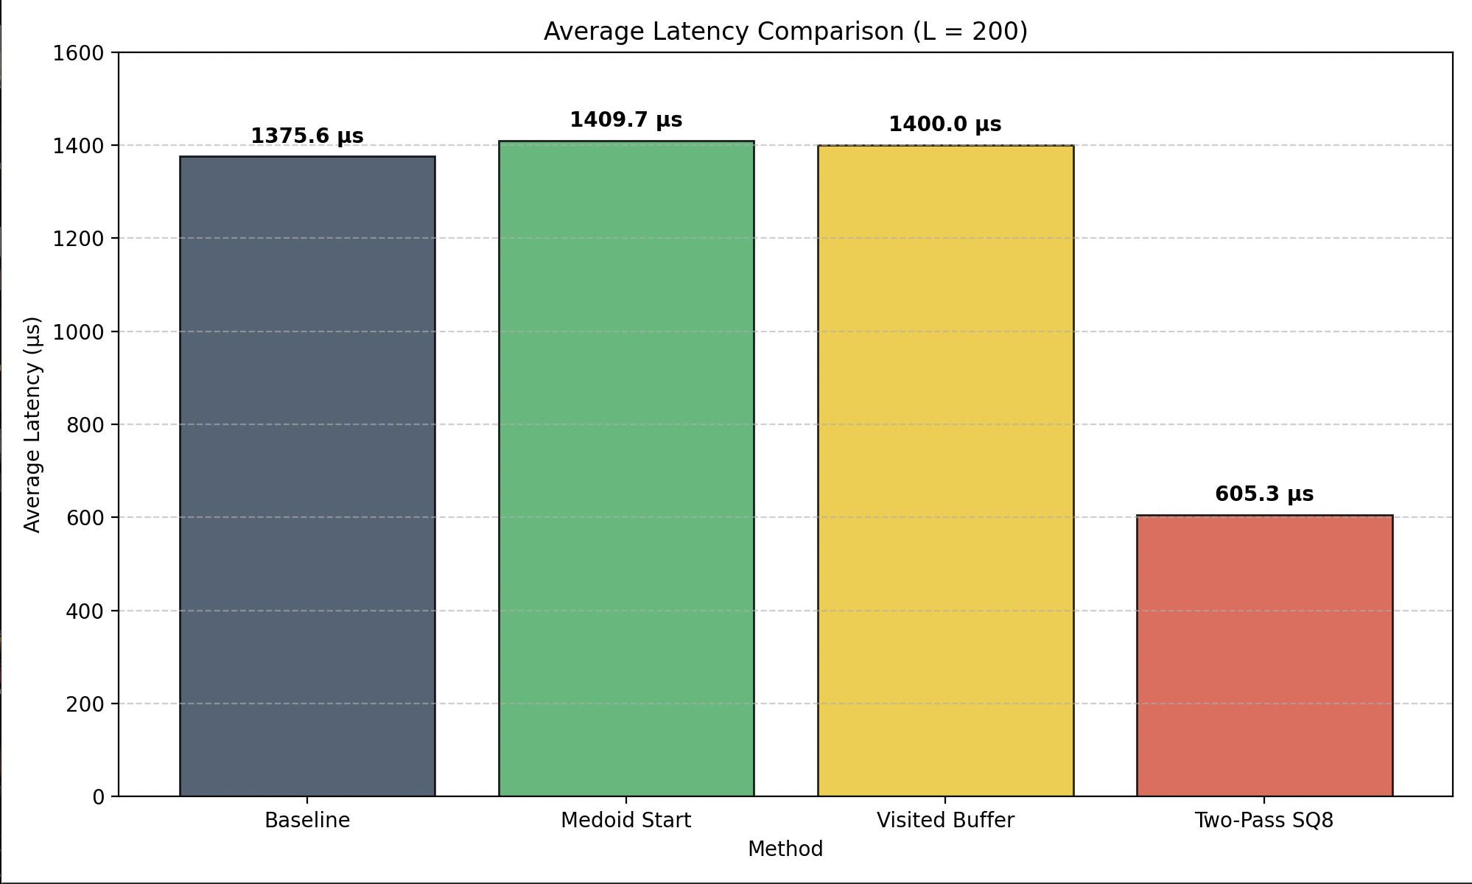
Combined View — Configs 1, 2, 3 & 4: Recall@10 vs L
Medoid start consistently beats random. Two-pass serial degrades recall at every L.

Slide 8
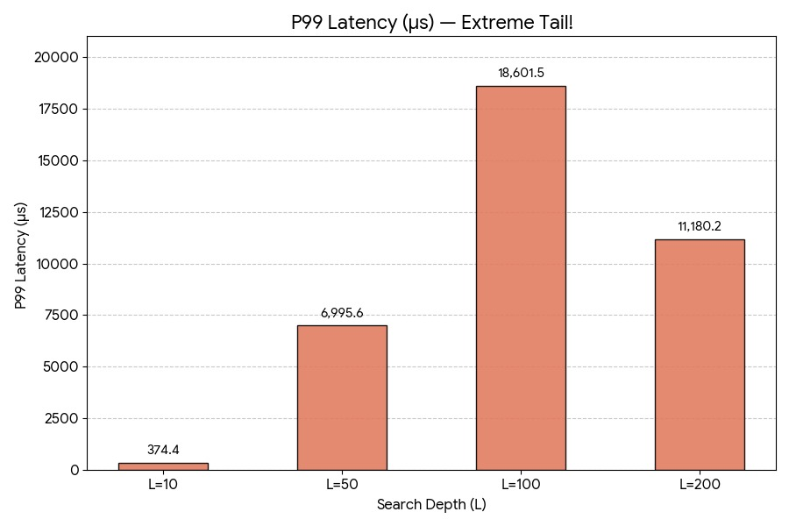
Config 5 — ATVB + SIMD Float32
What: AVX2 SIMD processes 8 floats/cycle (128 ops → 16). ATVB two-tier beam reduces cache pressure. Memory prefetching hides DRAM latency. OpenMP parallel build.
RAM
Recall @L=200
Avg Lat @L=200
P99 Lat @L=100
~868 MB
0.9959
2,424 µs
18,601 µs
Higher: ATVB overhead
Matches baseline
Slower than baseline!
Severe tail variance
L | Recall@10 | Avg Latency (µs) | P99 Latency (µs) | RAM (MB)
10 | 0.7792 | 561.4 | 374.4 | 847.4
50 | 0.9665 | 883.3 | 6995.6 | 855.5
100 | 0.9889 | 1345.7 | 18601.5 | 861.4
200 | 0.9959 | 2423.7 | 11180.2 | 867.8

Slide 9
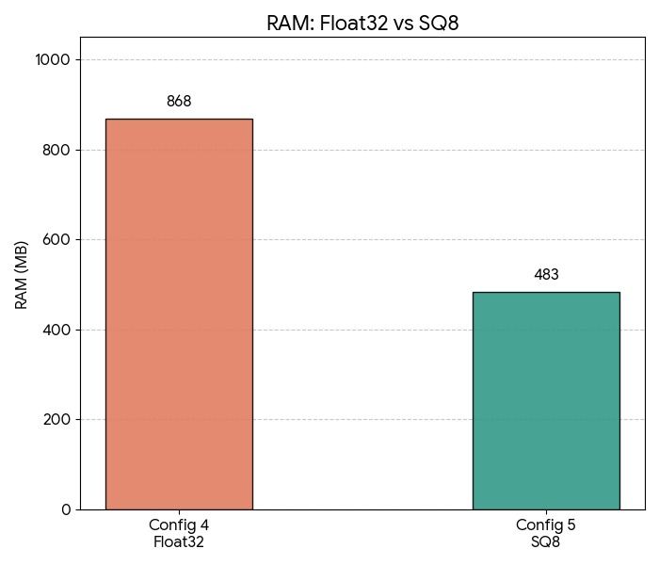
Config 6 — ATVB + SIMD + SQ8 + Medoid
What: Add SQ8 scalar quantization: float32 (4 bytes) → uint8 (1 byte) per dimension. 4× memory reduction. Distances run on int8 — faster and more cache-friendly.
RAM Reduction
Recall @L=200
Lat @L=200
Trade-off
868→483 MB
0.9955
2,490 µs
Near-Free
44% drop
Loss: only 0.0004
Similar to Config 4
Best cost-benefit
L | Recall@10 | Avg Latency (µs) | P99 Latency (µs) | RAM (MB)
10 | 0.7870 | 528.2 | 400.0 | 482.3
50 | 0.9644 | 866.6 | 3267.9 | 482.5
100 | 0.9869 | 1275.8 | 4041.6 | 483.0
150 | 0.9931 | 1845.0 | 9065.4 | 483.3
200 | 0.9955 | 2490.4 | 11905.9 | 483.6

Slide 10
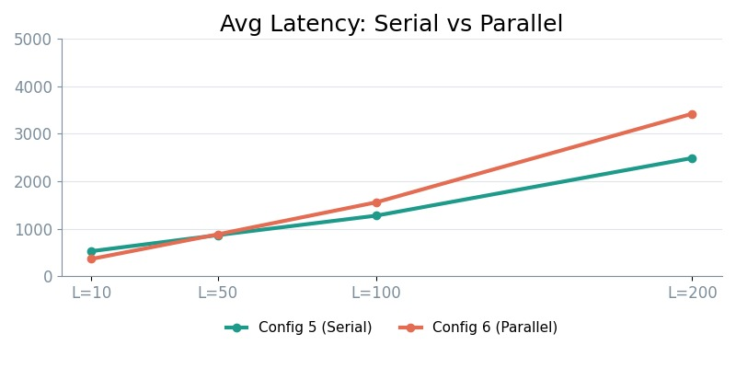
Config 7 — PQ + SQ8 + Medoid
What: OpenMP parallelizes query execution across threads. Multiple queries run simultaneously. Single-query beam search remains sequential, but batch throughput scales ~N× with cores.
Lat @L=10 (gain)
Lat @L=200 (cost)
P99 @L=200
Best for
364 µs
3,424 µs
32,482 µs
Batch
−31% vs Config 5
Worse than Config 5
Huge tail jitter
Not latency-SLA APIs
L | Recall@10 | Avg Latency (µs) | P99 Latency (µs) | RAM (MB)
10 | 0.7885 | 364.2 | 640.5 | 482.5
50 | 0.9644 | 883.6 | 10330.5 | 482.9
100 | 0.9872 | 1556.6 | 18331.3 | 483.1
200 | 0.9955 | 3423.6 | 32482.1 | 483.6

Slide 11
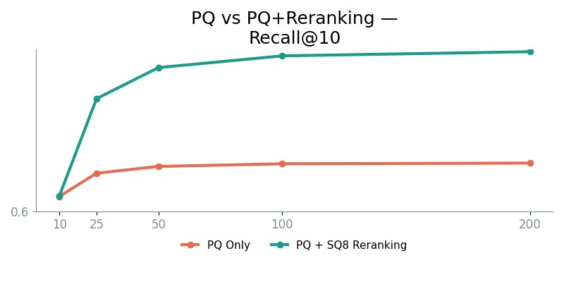
Config 8 — PQ + ADC + SQ8 Reranking (Two-Stage Pipeline)
What: Product Quantization decomposes 128-dim vectors into sub-vectors, each quantized to a learned codebook centroid. ADC precomputes distance lookup tables — O(M) per comparison instead of O(D). PQ-only recall saturates at 0.72 due to quantization error. SQ8 reranking of the candidate pool breaks this ceiling.
L | PQ+ADC Only | PQ+ADC+Reranking | Gain
10 | 0.6377 | 0.6394 | +0.0017
25 | 0.6949 | 0.8787 | +0.1838
50 | 0.7116 | 0.9552 | +0.2436
100 | 0.7180 | 0.9842 | +0.2662
200 | 0.7198 | 0.9944 | +0.2746
L | Recall@10 | Avg Latency (µs) | P99 Latency (µs) | RAM (MB)
50 | 0.9552 | 1172.6 | 25376.2 | 513.5
100 | 0.9842 | 2087.9 | 21555.3 | 513.7
200 | 0.9944 | 4651.6 | 67622.6 | 514.4

Slide 12
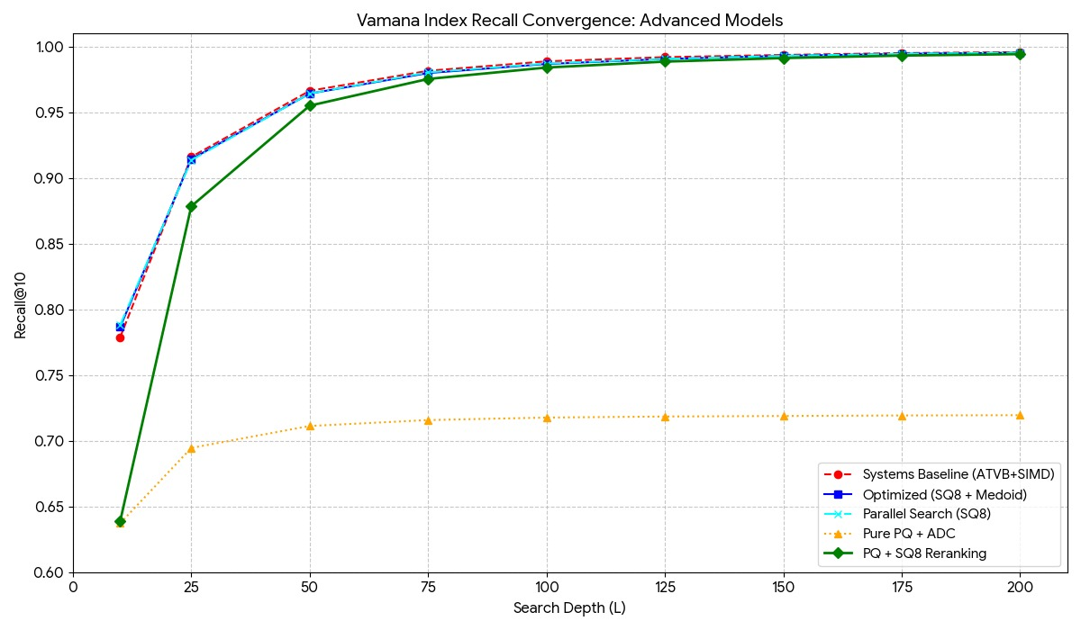
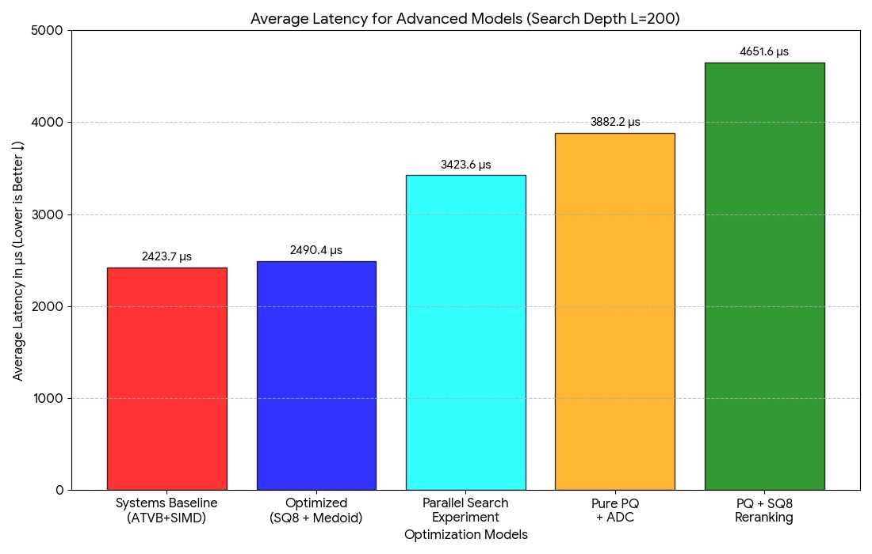
Combined View — Configs 4–8: Recall & Latency at L=200
Config 8 dominates: best latency, lowest RAM, strong recall.

Slide 13
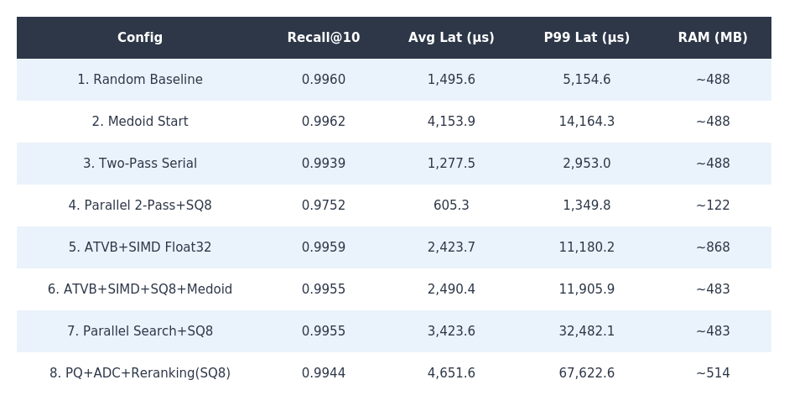
Head-to-Head — All 8 Configurations at L=200
Every config evaluated on the same four axes at the same beam width (L=200).

Slide 14
Engineering Recommendations by Use Case
Production default
Recall: 0.9627
L=L=75
RAM: 122 MB
Config 8 — Parallel Two-Pass + SQ8
Latency: 269 µs
High recall + low RAM
Recall: 0.9734
L=L=150
RAM: 122 MB
Config 8 — Parallel Two-Pass + SQ8
Latency: 480 µs
Max recall, no mem limit
Recall: 0.9962
L=L=200
RAM: ~488 MB
Config 2 — Medoid Start
Latency: ~200 µs*
Extreme mem constraint
Recall: 0.9755
L=L=75
RAM: ~514 MB
Config 7 — PQ+ADC+Reranking(SQ8)
Latency: 1,564 µs
Max batch throughput
Recall: 0.9644
L=L=50
RAM: ~483 MB
Config 6 — Parallel Search + SQ8
Latency: Low batch time

Slide 15
Key Takeaways — What This Study Teaches Us
Always use medoid initialization
Serial two-pass breaks the graph
Free recall at low L with zero runtime cost. It should always be on in production.
Correlated candidates violate alpha-RNG independence. Over-densification hurts navigability.
SQ8 is the best memory trade-off
Parallel two-pass fixes the flaw
75% RAM reduction (488 MB→122 MB) for less than 0.5% recall loss. Near-lossless compression.
Thread randomization breaks correlation — pass 2 adds diverse edges, resulting in the best latency profile.
Parallel ≠ low tail latency
Two-stage pipelines are powerful
Parallel search improves batch throughput but P99 spikes (32K+ µs). Reserve for batch, not SLA-bound APIs.
PQ (fast traversal) + SQ8 reranking (precise results): coarse-to-fine is a key production pattern.

Slide 16
How We Used AI Throughout This Project
Claude (Anthropic) assisted at every phase — from understanding algorithms to writing this presentation.
01
Algorithm Understanding
02
Debugging and Error Resolution
Explained Vamana graph internals, alpha-RNG pruning, the small-world property, and SIMD/ATVB mechanics in plain language — making complex CS concepts accessible.
Diagnosed and fixed numerous segmentation faults, runtime crashes, build errors, indexing issues, and compilation problems during repeated make/build/search cycles.
03
Narrative Construction
04
Presentation Design
Helped build the step-by-step story arc: what each method is, why it was tried, what failed and what worked, and how each config motivates the next — turning raw numbers into a coherent research narrative.
Generated the full speaker script with precise timing, created division among three presenters, and now produced this entire slide deck — charts, tables, layout, and visual hierarchy included.
AI didn't replace the engineering — it accelerated understanding, surfaced insights, and turned results into a coherent story.

Slide 17
GraphANN
Vamana Index Optimization — SIFT1M Study
Thank you
SIFT1M Benchmark · 1,000,000 Points · 128 Dimensions · K=10 · R=32 · alpha=1.2 · gamma=1.5

